Slide 1
CS 39006: Computer Networks Lab – The Select() System Call

Slide 2
An Example – Peer to Peer Chat Application
Hello Bob, What’s up
Hi Bob: How are you?
Hi Alice
Hi Jane, Bob is there

Slide 3
Peer to Peer Chat Application
No central server to control chat message delivery
Every user run’s its own chat server (a TCP server for incoming connections and messages)
Note, UNIX maintains every connection (socket) as a file descriptor
You are also reading data from the STDIN (the standard input file descriptor) – here the keyboard
Message communication is asynchronous – you can receive a message while typing

Slide 4
The select() system call
Selects from multiple file descriptors – a concurrent way to handle multiple file descriptors simultaneously, even from a single process or thread
What happens in an iterative server implementation that you have done earlier?
accept() call is blocked until you have completed the read() and write() calls
What if you do multiples read() and write() activities after accepting an incoming connection? – all other connections are blocked and waiting in the connection queue (may get starved !!!)
select() is the way to break this blocking
Advantage: You do not need to create multiple child processes now. No need to worry about zombies !!!

Slide 5
Select is a Multiplexer …

Slide 6
How the select() call works
highest-numbered file descriptor in any of the three sets, plus 1
Read file descriptors
Write file descriptors
int select(int nfds, fd_set *readfds, fd_set *writefds,
fd_set *exceptfds, struct timeval *timeout);
exception file descriptors
A timeout value
Synchronous I/O multiplexing over asynchronous inputs

Slide 7
The Three File Descriptors
readfds will be watched to see if characters become available for reading
writefds will be watched to see if space is available for write
exceptfds will be watched for exceptional conditions

Slide 8
The Timeout in Select
Timeout: the interval that select()should block waiting for a file descriptor to become ready. The select() call will block until either
A file descriptor becomes ready
The call is interrupted by a signal handler; or
The timeout expires.
struct timeval
{
long tv_sec; /* seconds */
long tv_usec; /* microseconds */
};

Slide 9
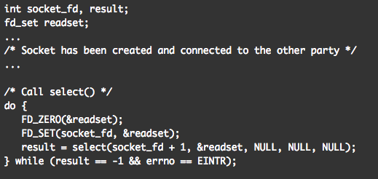
How Do You Pass the File Descriptors to Select
FD_ZERO: Initializes the file descriptor set fd_set – a bitmap of fixed size
FD_SET: Set a file descriptor as a part of a fd_set

Slide 10
How Select Works
Loops over the file descriptors
For every file descriptor (FD), it calls that FD's poll() method, which will add the caller to that FD's wait queue, and return which events (readable, writeable, exception) currently apply to that FD.
If any file descriptor matches the condition that the user was looking for, select() will simply return immediately, after updating the appropriate FD_SETs that the user passed.
If not, however, select() will go to sleep, for up to the maximum timeout the user specified.

Slide 11
How Select Works
If, during that interval, an interesting event happens to any file descriptor that select() is waiting on, that FD will notify its wait queue.
This will cause the thread sleeping inside select() to wake up,
It will repeat the above loop and see which of the FD's are now ready to be returned to the user.
Return values of select()
-1: Means an error was encountered, you should do something about it. I just print the error
0: Means the call timed out without any event ready for the sockets monitored
>0: Is the number of sockets that have events pending (read, write, exception)

Slide 12
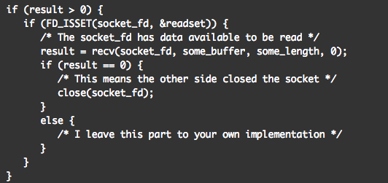
After Select Returns
FD_ISSET: tests to see if a file descriptor is part of the set

Slide 13
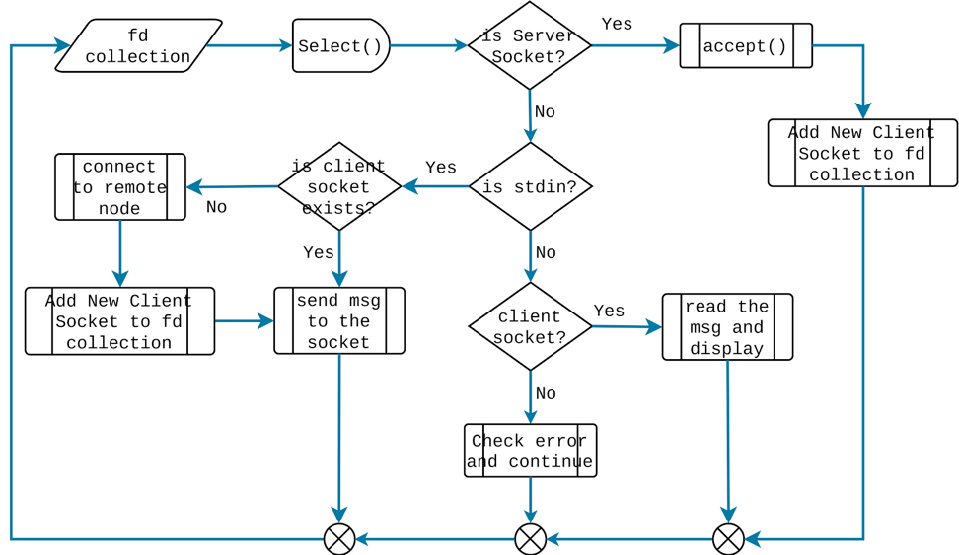
Coming back to our P2P Chat Application …

Slide 14
Your Next Assignment …
Implement this chat application and chat among yourselves !!!

